Slide 1
Zipkin Demo
With a simple microservices project

Slide 2
Agenda
Zipkin Architecture
Introduction to Microservices project
Demo
Introduction to Google Dapper
Introduction to Spring Cloud Sleuth
Apache Skywalking

Slide 3
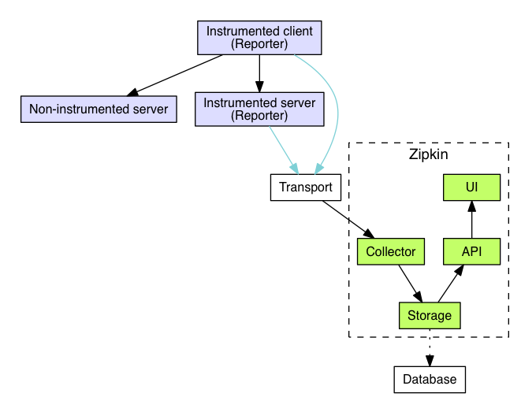
Zipkin Architecture
Official Website: here

Slide 4
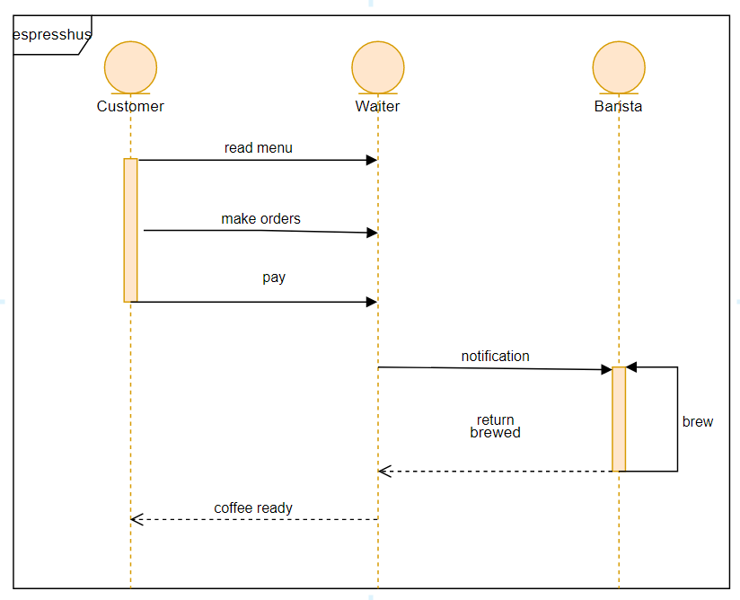
Sequence

Slide 5
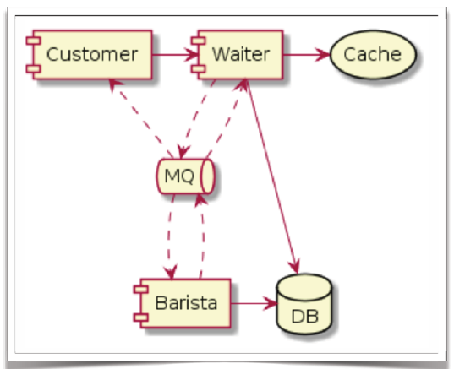
Components

Slide 6
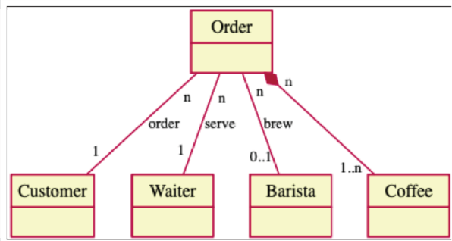
Class

Slide 7
Project Structure
ROOT
final-barista-service/
final-customer-service/
final-waiter-service/
mq-zipkin-barista-service/
sleuth-customer-service/
sleuth-waiter-service/

Slide 8
Demo
git clone https://github.com/beiji-ma/zipkin-demo.git

Slide 9
Google Dapper
Span
Trace
Annotation
cs – Client Set
sr – Server Received
ss – Server Sent
cr –Client Received

Slide 10
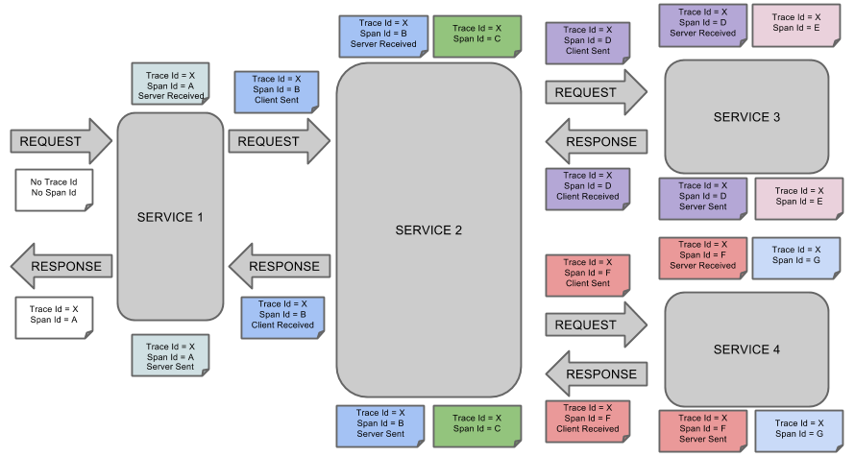
Google Dapper

Slide 11
Spring Cloud Sleuth
Dependency
Spring Cloud Sleuth – spring-cloud-starter-sleuth
Spring Cloud Sleuth with Zipkin – spring-cloud-starter-zipkin
Logging
[appname,traceId,spanId,exportable]

Slide 12
Spring Cloud Sleuth
Configuration
spring.zipkin.base-url=http://localhost:9411/
spring.zipkin.discovery-client-enabled=false
spring.zipkin.sender.type=web | rabbit | kafka
spring.zipkin.compression.enabled=false
spring.sleuth.sampler.probability=0.1

Slide 13
Apache Skywalking
here

Slide 14

Thanks

